Slide 1

Data Flow Diagram
Classroom Management System
Tasnim Ferdous 180041108
Sidratul Muntaha 180041118
Farhan Ishmam 180041120

Slide 2
Data Flow Diagram
DFD graphically characterizes data processes and flows in a business system.
DFD
02

Slide 3
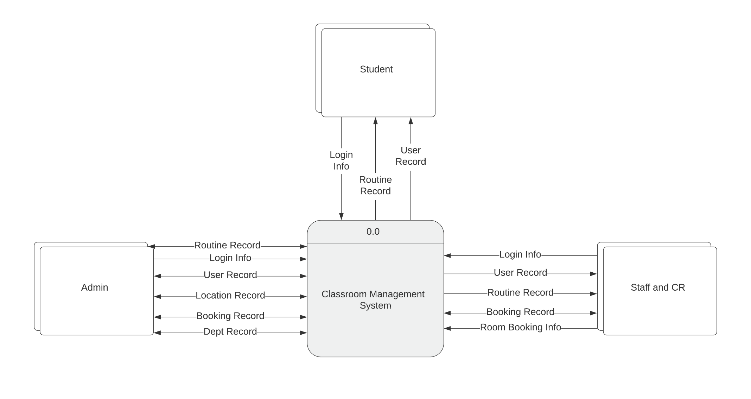
CONTEXT DIAGRAM
JANUARY
03

Slide 4
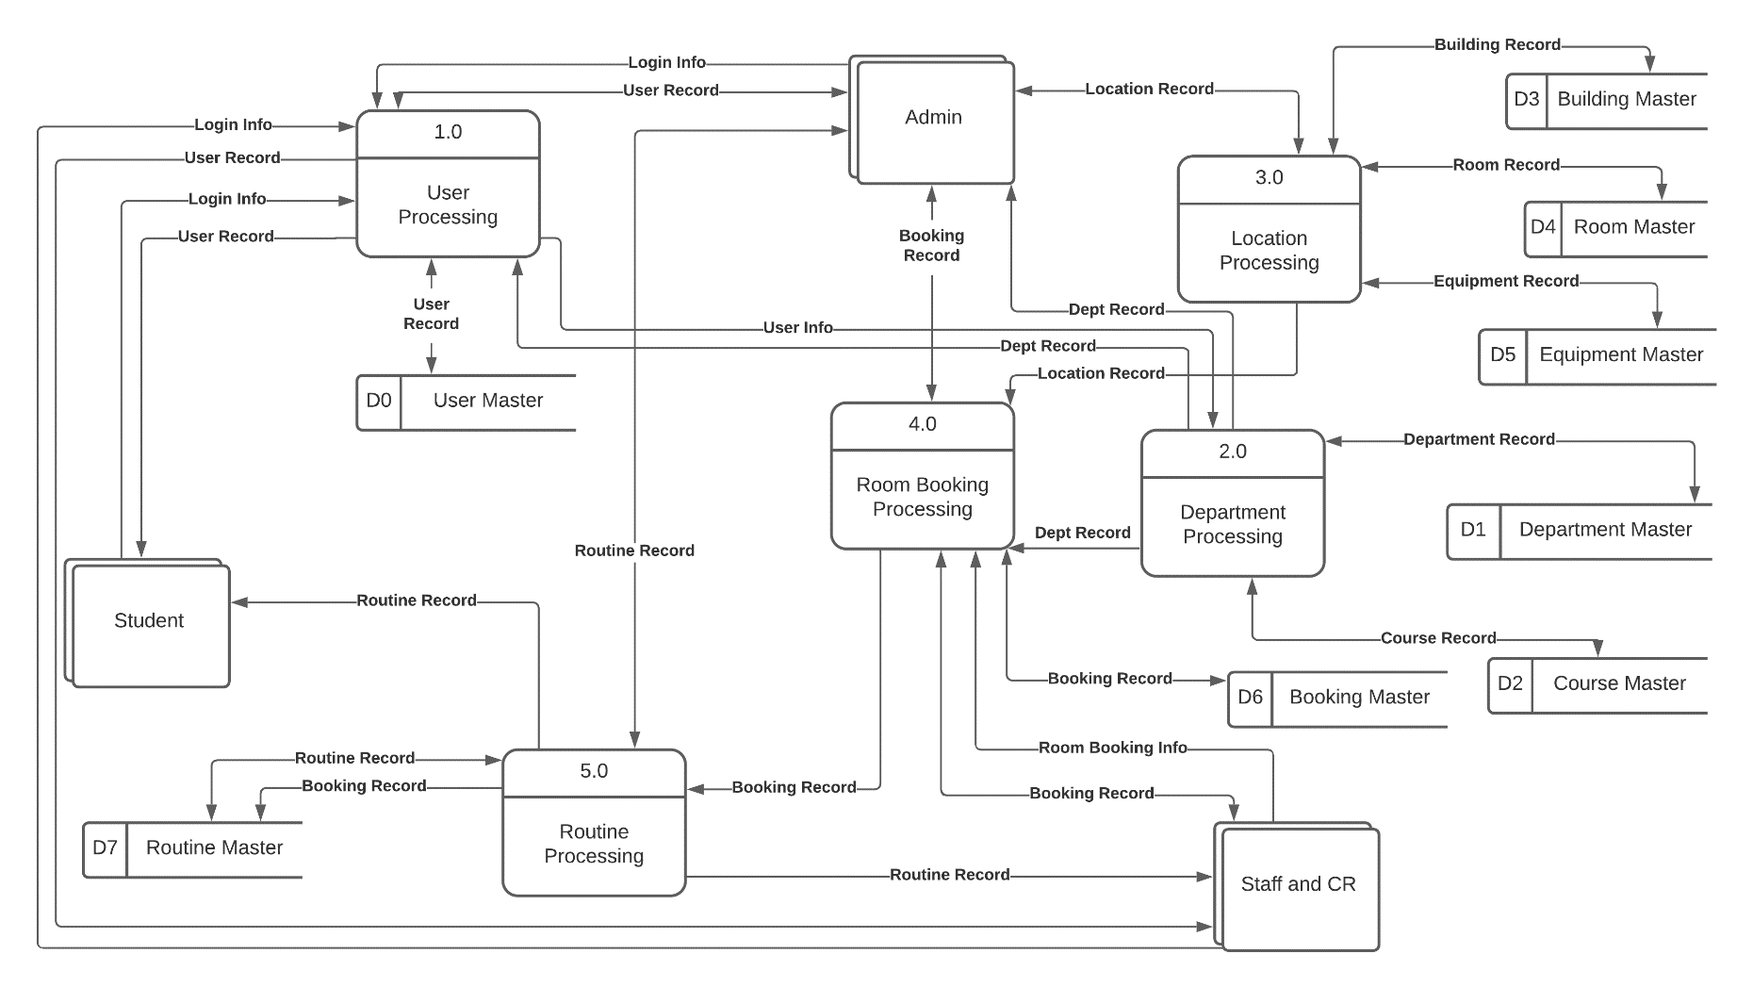
DIAGRAM 0
JANUARY
04

Slide 5
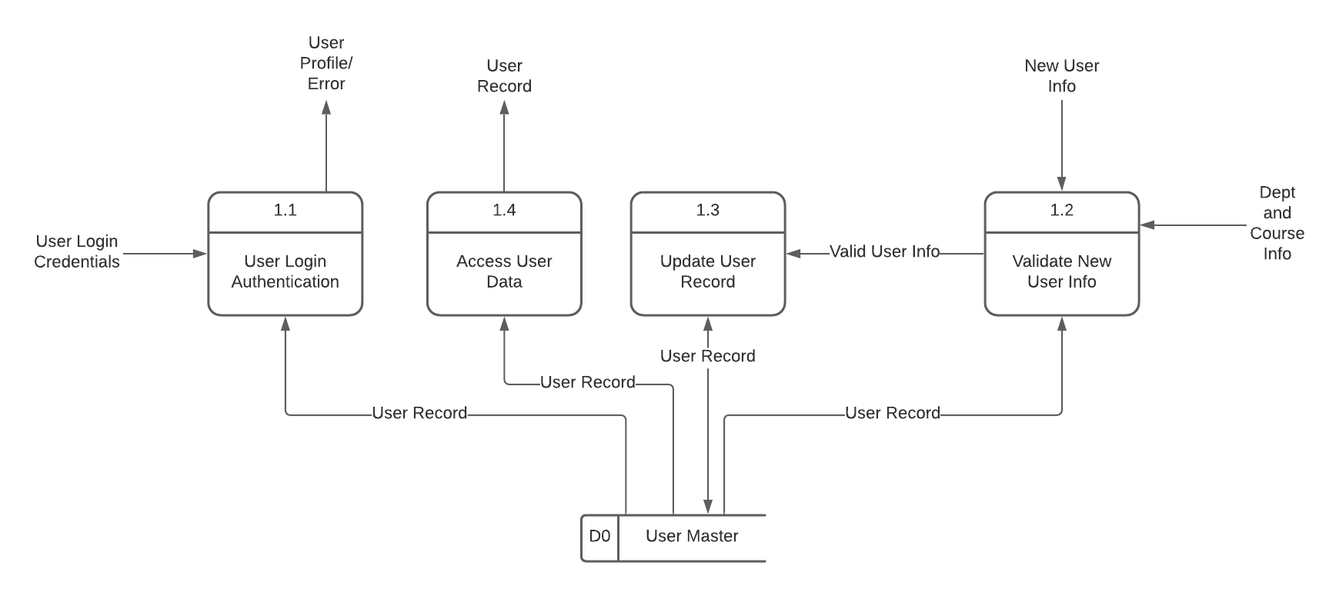
CHILD DIAGRAM 1
05

Slide 6
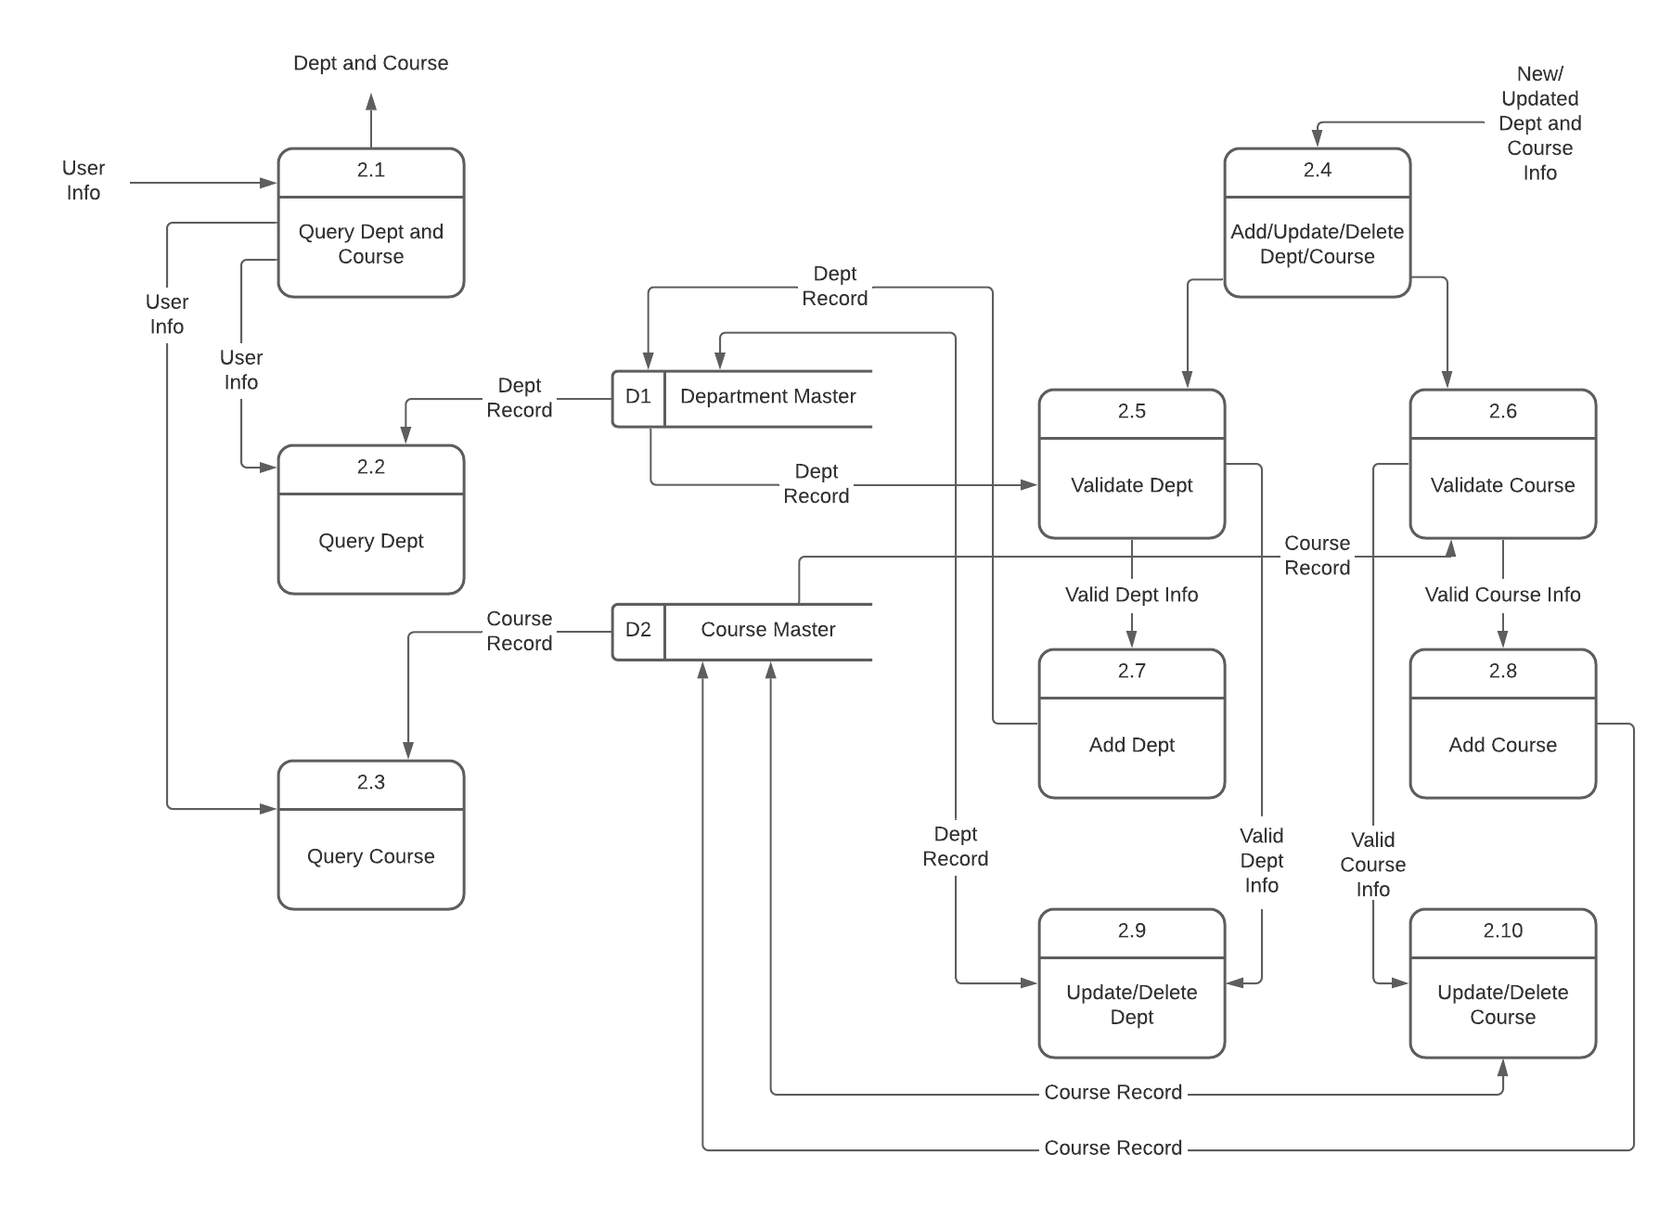
CHILD DIAGRAM 2
06

Slide 7
THANK YOU

